Slide 1
US06CMIC24
Fermentation Technology-II
Unit-4 Fermentative production of specific microbial products
Microbial Biomass : Brewers and Baker’s Yeast
- Industrial Microbiology by A.H.Patel - Page no.171-176
Primary Metabolites: Glutamic acid, Cyanocobalamine, Ethanol
- Industrial Microbiology by A.H. Patel - Page no.158-160,
162-166, 145-150
Secondary Metabolite: Penicillin
- A text book of industrial microbiology Crueger and Crueger.-
Page no. 233-240
Enzymes: Alpha amylase only
- A text book of industrial microbiology Crueger and Crueger –
Page no. 191-195

Slide 2
Biotransformation: Steroid Transformation
- An Introduction to Industrial Microbiology: S. Chand Publishers;
Page no. 132-133
Recombinant Product: Insulin
- An Introduction to Industrial Microbiology: S. Chand Publishers;
Page no. 133-135
Fermented Foods: Yoghurt
- Industrial Microbiology by A.H.Patel Page no. 212-215

Slide 3
INTRODUCTION
Yeasts constitute an interesting group from a technical and
industrial standpoint in the microbial world.
They can be isolated from many source materials (e.g. soil,
grape and curd) by the use of suitable media.
There are some species and strains of yeast which are used
commercially. The well-known commercial uses of yeasts are in
alcoholic beverage production, baking, food stuffs, animal feed
and the production of biochemicals.
Strains of Saccharomyces cerevisiae, among known genera and
species of yeast, are of the greatest technical importance.
Yeasts can be grown on media containing essential nutrients for
the development of yeast. Essential nutrients include
assimilable carbohydrate, nitrogen, trace elements, phosphate,
sulphate and its vitamins (usually biotin).

Slide 4
In addition to essential nutrients, other growth stimulators,
such as amino acids, inositol, thiamin, pantothenate, riboflavin
and PABA are added to the medium to accelerate yeast growth.
Media, such as brewers' wort, grape musts and apple juice
contain all the essential and non-essential growth stimulating
nutrients.
These media serve to propagate those yeasts of the genus
Saccharomyces which are used to produce alcoholic beverages.
Commercial production of those yeasts used for baking,
distilling and as food and animal feeds and biochemicals is
carried out on media based on molasses, cheese whey, sulfite
liquor and gas oil fractions. But these media usually need to be
supplemented by essential or/and non-essential growth
stimulating nutrients, as the case may be. In other words,
media based on these raw materials are incomplete.

Slide 5
These media are widely used because they are considerably
less expensive and are not so susceptible to seasonal variations
in supply as worts, musts and apple juice are.
Thus, molasses-based media are employed for the large-scale
production of baking yeasts, food yeasts and distillers' yeasts.
Yeasts are commercially produced aerobically by batch
processes.

Slide 6
PRODUCTION OF BREWERS' YEAST
Brewers' yeast is cultivated on hopped malt wort. Thus, this is a
considerably simpler process than the production of bakers'
yeast.
The sterilization of the production plant is carried out by the use
of live steam.
On the other hand, the hopped wort medium is pasteurized. The
pasteurization of medium is carried out, either by boiling the
medium present in the production tank, or separately, before
passing the medium into the production tank.
A typical system would consist of two propagating closed vessels
of 33hl (20 barrels) capacity.
Each vessel would be inoculated with 100 grams pressed yeast
(The pressed yeast is produced from laboratory stocks by culture
in sterile wort, and aerated for one minute in five vessels at 0.11
m³ air per vessel).

Slide 7
There is the necessity of intermittent aeration without agitation.
But it is not necessary to control pH and to feed incrementally.
Maintenance of the culture at 20°C. is carried out by means of
the exterior cooling jackets.
The yeast mass increases exponentially to give 17 grams pressed
yeast per liter after 48 hours.
The culture is then used directly to inoculate fermentation
vessels. The usual rate of inoculation is of the order of 10-20%
by volume. This type of propagation ensures that the yeast
develops fermentatively (it is catabolite-repressed by the wort
sugars, mainly maltose).
The empirical equation for the brewers' yeast production is as
shown below:
Maltose + Ammonia Yeast + Ethanol + CO₂
200 gms. 1 gm 10 gms. 97-5 gms. 93.6 gms.

Slide 8
There is the liberation of 100 K.Cal. of heat energy per 10 gms. of
yeast (18,000 Btu/lb.).
In addition to the direct propagation of brewers' yeast described,
breweries routinely crop their production fermentors and re-use
part of the yeast so obtained. Therefore, direct propagation is
used regularly but intermittently to produce fresh and pure yeast
stocks.
The surplus brewers' yeast is sold to manufacturers of yeast
products for dietary supplementation.
The treatment of yeasts for the production of wines and ciders is
similar to that described for brewers' yeast. Musts and apple
juices, however, are sterilized by SO₂ addition,

Slide 9
PRODUCTION OF BAKERS' YEAST
Bakers' yeast is propagated on beet molasses-, refiners' cane
molasses or black-strap molasses-based media. It is a common
practice to mix beet molasses and black-strap molasses in the
preparation of the production medium.
The reason for blending these two types of molasses is the higher
assimilable nitrogen content and lower biotin content of beet
molasses than is the case of black strap molasses.
The molasses are diluted with water, pasteurized, blended and
supplemented with the following compounds:
Ammonia (basic) and ammonium sulphate (acidic) to a
pH of 4.0-4.5,
Diammonium hydrogen phosphate, and
Magnesium sulphate.
In addition to the above mentioned compounds, biotin, and often thiamin or yeast extract are added.

Slide 10
A small amount of the production medium is allowed to pass
into the sterile, closed production fermenter.
The inoculation of the fermentor is then done with either cream
yeast or yeast propagated fermentatively in successive seed
cultures from laboratory cultures.
Sterile air is introduced into the fermenter throngs a horizontal
array of perforated tubes at the bottom of the vessel, or down
the centre of a motor-driven impeller and it is let out through the
impeller blades.
The cells of the inoculum use the available nutrients, and fresh
medium is fed incrementally into the vessel.
This Zealand (for batch) process is necessary, since high
concentrations of sucrose, glucose and fructose (the sugars in
molasses) redress respiratory enzymes.
Since the growth of the yeast cell is exponential, exponentially
increasing amounts of medium are fed to keep the ratio of the
cell mass to sugar constant.

Slide 11
The aeration rate is accordingly adjusted.
The rapid growing, vigorously aerated culture produces a
considerate amount of foam.
Either poly-propylene glycols or silicone antifoams may be used
for suppressing the foam.
Heat production occurs as a result of the metabolism of the yeast
cells, Therefore, it is essential to maintain temperature at 30 ̊C.
This is accomplished by circulating coolant through internal coils.
It is also required to maintain pH in the range of 4.0-4.5. This is
accomplished by the addition of suitable amounts of ammonia
and ammonium sulphate or ammonia and sulfuric acid.
The empirical equation derived by Harrison for bakers' yeast
production is:
Sucrose + Ammonia + Oxygen Yeast + Water + CO₂
200 10.4 102.5 100 77.2 145.6
gms. gms. gms. gms. gms. gms.

Slide 12
There is liberation 387 K. Cal. of heat is generated during the
production of 100 gms. of yeast.
The pH of the fermentation broth is allowed to rise during the
end period of the process. By doing so, yeast cells are made free
of the adsorbed colored material, Finally, the addition of
nutrients is stopped and aeration is continued for 30-60 minutes.
This maturation or ripening process allows cell division to be
completed and reduces the number of budding cells to less than
20% of the total population. Bud counts greater than 20% reduce
the keeping properties of the yeast.
The final culture contains approximately 50 gms, dry matter per
liter.
The yeast cells are separated from the bulk of the liquid. These
cells are collectively called yeast cream. The yeast cream is
washed with water and centrifuged. Thus, the product containing
200 gms. dry matter per liter is obtained.

Slide 13
This product is further dried on rotary vacuum filters. Salt added
prior to filtration shrinks the cells.
These cells are subjected to spraying with water on the filter. As a
result of this, cells get swollen because they take up extracellular
water.
This results in the formation of a dryer product containing
30 % dry matter content.
Water and plasticizers may be added to the product scraped from
the filter. And this facilitates the formation of blocks of yeast.
Those blocks must be kept at low temperature until they are
used.
Pressed bakers' yeast is gradually being replaced by active dried
yeast. The method of production of active dried yeast is similar
to that of pressed yeast with the following exceptions:

Slide 14
Specially-bred yeasts, which offer stability against drying, are
used.
Nitrogen and sugar feeds are restricted towards the end of the production methods.
Separation and filtration are designed to give products of some 35 percent dry matter.
The yeast mass is extruded through a screen and chopped.
The pellets are dried in a tunnel or rotary driers for 6-24
hours.
The product is packed in airtight containers.
The advantages of dried yeast are:
(i)It has less bulk than pressed bakers' yeast.
(ii) It may be stored at amient temperatures,
(iii) It is readily reconstituted by dispersion in warm water.
The major disadvantage is its lower activity, 65 percent of that of
pressed yeast.

Slide 15
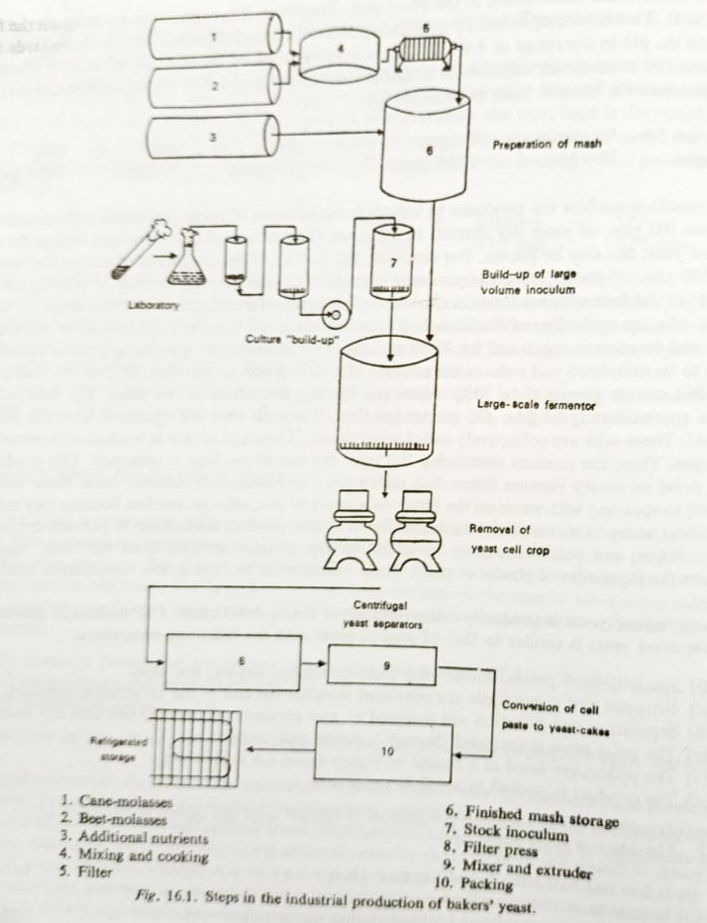

Slide 16
Primary Metabolites: Glutamic acid, Cyanocobalamine, Ethanol
Fermentative production of L-glutamic acid
A derivative of glutamic acid, monosodium glutamate, is used to
develop a flavor in food products (e.g. soups).
The commercial production of this acid in the world exceeds
1,00,000 tons per annum.
L-Glutamic acid may be produced in many ways:
by the hydrolysis of wheat gluten, soyabean cake, or other
proteinaceous material;
(b) by the cleavage of the pyrrolidone carboxylic acid found in Steffen's molasses;
(c) by a one-stage fermentation process involving a single micro-organism;
(d) by a two-stage fermentation process where a-ketoglutaric acid is produced by one microbe and α-ketoglutaric acid, in turn, is converted to L-glutamic acid by another microbe.

Slide 17
Nowadays, a one-stage process utilizing Corynebacterium
glutamicum is mainly adopted produce L-glutamic acid on a
large-scale, Japanese workers have obtained high-yielding
mutants of this microbe.
Glucose and starch hydrolysates are the principal raw materials
for the fermentative production of amino acids, More efforts
have been made to replace these materials with such cheaper
and more easily available ones as molasses, ethanol, pentose,
acetic acid and other petrochemicals.
The fermentative production of L-glutamic acid from various
carbon sources is given in Table

Slide 18
Industrial production of L-glutamic acid using glucose as the
carbon source was initiated in 1957 by Kyowa Hakko Kogyo Co.
It is necessary to add a limited amount of biotin to the
production medium.
The quantity of biotin needed is in the range of 1 to 5µg./ltr.
The accumulated glutamic acid gets excreted through the cell-
wall by the mechanism involving biotin. With inexpensive raw
materials, fine control of biotin in glutamic acid fermentation is
not possible.
Glutamic acid formation and its excretion occur even at higher
biotin concentrations, provided the fermentation medium is
supplemented by penicillin or detergents.
Moreover, the use of antibiotics, penicillin, allows us to use sugar
cane waste molasses in place of pure glucose as a carbon
substrate.

Slide 19
Urea or ammonia may be used as nitrogen sources. Also,
phosphates and other ordinary salts are added to the production
medium in the manufacture of glutamic acid.
The production medium is slightly alkaline in reaction.
The temperature to be maintained in Corynebacterium
glutamicum-L-glutamic acid fermentation is 30°C.
The duration of the fermentation period is 40 hours.
The carbon source may be converted to glutamic acid in 50 per
cent of the yield under optimum aerobic conditions.
Biochemistry of L-glutamic acid fermentation
In the case of Corynebacterium glutamicum, the sugars are
metabolized via the glycolysis. There fore, formation of glutamate
does not occur if classical inhibitors of glycolytic pathway (e.g.
fluoride and iodoacetate) are present.
Owing to the absence of an a-ketoglutarate dehydrogenase in the
mutant, accumulation of glutamate occurs. Thus, the citric acid
cycle is not complete (Fig. 14.2).

Slide 20
Principal intermediates in the production of glutamic acid from glucose.
Glucose cis-Aconitate
Phosphoenolpyruvate iso-Citrate
Pyruvate CO₂
CO₂ CO₂ α-Keto glutarate
Oxaloacetate Acetyl COA
Citrate GLUTAMATE
The energy is provided by a glyoxylate pathway.
The accumulation of glutamate continues until a saturation point
is reached (50 mg./g. dry weight of cells).
Subsequently, excretion of the glutamate into the medium occurs
in the absence of biotin. If molasses is used, addition of penicillin
or detergents during the exponential growth phase allows
excretion of glutamate.

Slide 21
Fermentative production of Cyanocobalamine (VITAMIN B₁₂)
INTRODUCTION
Vitamins are very important compounds in the diet because they
are of great value in the growth and metabolism of the living cell.
All the vitamins may be synthesized by prototrophic
micro organisms.
These compounds are constituted from simple ingredients
supplied by the growth medium But, they are produced in the
amounts enough to fulfill the organism's needs.
There are certain micro-organisms which excrete vitamins greatly
in excess of their own metabolic needs if grown under highly
specified and artificial conditions. Thus, such micro-organisms
are of industrial interest.

Slide 22
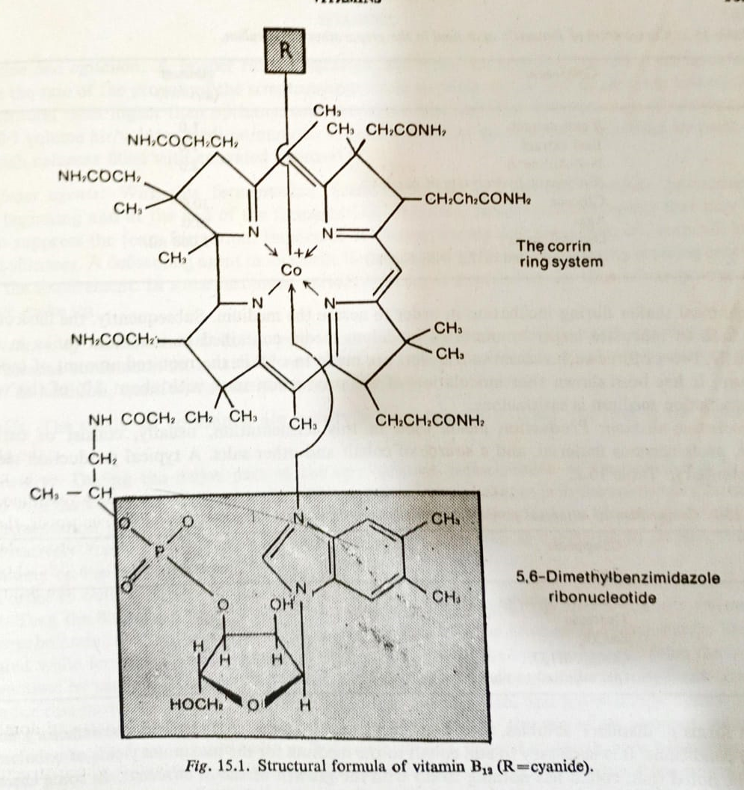
VITAMIN B₁₂
Vitamin B₁₂ is an important dietary component for normal growth in human beings and domesticated animals. Its daily requirement for human beings is 0.001 mg./day.
Looking to the chemistry of vitamin B₁₂, it is a complex chemical compound whose structural formula is as shown in figure.

Slide 23
It is cyanocobalamin, consisting of a molecule of cobinamide
linked to a nucleotide. The cobinamide molecule has central atom
of cobalt linked to a cyanide group, surrounded by four reduced
pyrrole rings joined to form a macro-ring.
Moreover, a number of carbon atoms carry methyl or other
substituent groups. The nucleotide is atypical in having 5, 6-
dimethyl benziminazole as its base, instead of a purine or
pyrimidine base.
Vitamin B₁₂, is entirely produced on a commercial basis by the
fermentation Generally, it is manufactured by primary
fermentation. In some instances, it is obtained from broths used
primarily for the production of antibiotics.
Micro-organisms that may be employed in the industrial
production of vitamin B₁₂, are: Streptomyces griseus, S. olivaceus,
Bacillus megaterium, B. coagulans, Pseudomonas denitrificans,
Propionibacterium freudenreichii, P. shermanii, and a mixed
fermentation of a Proteus spp. and a Pseudomonas sp.

Slide 24
Generally, Vitamin B₁₂ is manufactured by the submerged-
culture process. Aeration and agitation of the production
medium are essential. Usually, such fermentations are completed
in 3 to 5 days.
Vitamin B₁₂ production using Streptomyces olivaceus
NRRL B-1125
The factors affecting Streptomyces olivaceus NRRL B-1125-vitamin B₁₂ fermentation have been Briefly discussed here.
Preparation of inoculum :
In the building up of the inoculum, pure agar slant culture of
Streptomyces olivaceus NRRL B-1125 is inoculated and grown in
100 to 250 ml. of inoculum medium contained in Erlenmeyer
flasks.
These seeded flasks are to be kept on the platform of
a mechanical shaker during incubation in order to aerate the
medium.

Slide 25
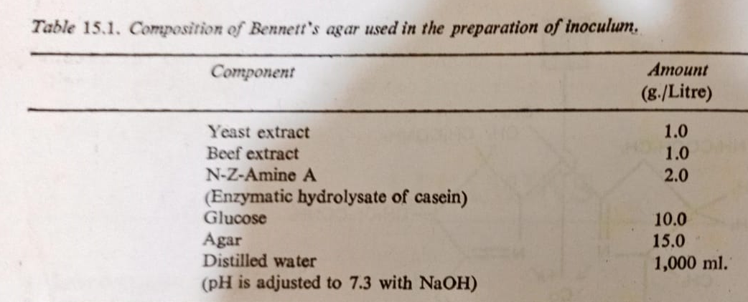
Subsequently, the flask cultures are used to inoculate larger
amounts of inoculum media contained in inoculum tanks in
series. Usually, two or three such successive transfers are made
to obtain the required amount of inoculum culture. It has been
shown that inoculation of the production tank with about 5% of
the volume of production medium is satisfactory.

Slide 26
Production medium:
Production media used in this fermentation, usually, consist of
carbohydrate, proteinaceous material, and a source of cobalt and
other salts.
Most forms of distillers' solubles, soya bean meal, yeast, casein,
etc. are found satisfactory under suitable conditions. It is
necessary to add cobalt to the medium for the maximum yields
of cobalamin.
It is to be noted that, cobalt has nothing to do with the growth of
the S. olivaceus.
In some cases, it is essential to add cyanide to the medium to aid
the conversion of other cobalamins to vitamin B_{12.}

Slide 27
Sterilization of the medium may be practised batch wise or
continuously. In batch wise sterilization, the medium contained
in the production tank is heated at 250°F. for 1 hour. In the latter
method, the production tank is charged (e.g. at 330°F. for 13
minutes) by mixing it directly with live steam.
Temperature:
A temperature of 80°F. in the production tanks is satisfactory
during fermentation.
pH:
There are a few tenths of a unit fall in pH and a rapid
consumption of sugar in the first 24 hours of the fermentation.
After 2 to 4 days, lysis of the mycelium begins resulting in the rise
of pH.
The stabilization of the mash is practised by reducing the pH to
about 5 with sulphuric acid and adding small amounts of a
reducing agent (e.g. sodium sulphite).

Slide 28
Aeration and agitation:
A proper rate of aeration and a correct speed of agitation are
essential because the rate of the growth of the streptomycete
strain depends on the rate of aeration and agitation.
Aeration rates higher than optimum cause excessive foaming.
The optimum rate of aeration is about 0.5 volume air volume
medium/minute.
The sterilization of air is, usually, practised by passing it through
columns filled with activated charcoal.
Antifoam agents:
With this fermentation, foam formation is a serious problem,
particularly at the beginning and at the end of the fermentation.
There are many antifoam agents that may be used to suppress
the foam formation. Important defoaming agents are: soya bean
oil, corn oil, lard oil and silicones.
A defoaming agent in its sterile form is added to the medium
during foaming according to the requirement.

Slide 29
In some instances, an antifoam agent is added at the time of the
production medium make up.
Prevention of contamination:
It is very essential to main sterility until the fermentation ends,
because contamination invariably results in very low yields.
Therefore, all equipments must be sterile.
In addition, transfers are carried out under aseptic conditions.
Yields:
The yields of cobalamin are usually in the range of 1 to 2 mg. per
liter in the fermented broth.
Recovery:
During the major part of the fermentation period, most of the
cobalamin is associated with the mycelium. But, a considerable
portion of the cobalamin is in the solution at the end of the
fermentation period.
Heating the mixture to boiling at pH 5 or below, liberates the
cobalamin quantitatively from the mycelium.

Slide 30
Broth containing cobalamin is subjected to further work-up.
In order to obtain crystalline vitamin B₁₂ the very first operation is
of filtration to remove mycelium. Then the filtered broth is
treated with cyanide to bring about the conversion of cobalamin
to cyanocobalamin.
The adsorption of the cyanocobalamin from the solution is
practised by passing it through an adsorbing agent packed in
columns. Several adsorbents are available for this purpose;
activated charcoal, bentonite, fuller’s earth, and ion-exchange
resins.
Elution of cyanocobalamin from adsorbent is accomplished by
the use of an aqueous solution of materials ranging from organic
bases to hydrochloric acid.
Several materials have been reported to this purpose: water,
water-acetone, and solutions of sodium cyanide or sodium
thiocyanate.

Slide 31
Thereafter, some type of extraction is usually carried out. It may
be countercurrent distribution between cresol, amylphenol, or
benzyl alcohol and water or a single extraction into an organic
solvent. (e.g. phenol). Precipitation as a copper or zinc cyanide-
cyanocobalamin complex has be reported.
Another purification step applicable to aqueous concentrates
consists in dissolving a zinc salt in slight acid solution and then
raising the pH to bring about precipitation of zinc hydroxide,
which eliminates many impurities.
Chromatography on alumina and final crystallization from
methanol-acetone, ethanol-acetone or acetone-water, usually
complete the process.
In order to obtain a concentrate of vitamin B₁₂ to use as feed-
supplement, the final fermented broth is evaporated to dryness.
These final broths containing about 3% solids are first subject
evaporation in vacuo to a solids content of 15 to 20%.

Slide 32
Then the syrups are drum-dried or spray-dried. The concentrates
obtained in this way by cobalt-supplemented fermentation may
contain 10 to mg/lb. of cobalamin.
Vitamin B production using Propionibacterium freudenreichil:
Species of the genus Propionibacterium have been reported to
produce the highest yields of vitamin B₁₂ For example,
P. freudenreichil has been reported to produce 20 mg, per liter.
The production medium containing glucose, corn-steep, betaine,
and cobalt has been shown to be satisfactory.
Betaine is added to the medium to furnish methyl groups.
Betaine, probably, does this by aiding in the synthesis of
methionine acting as a methyl donor.
The concentration of betaine in the medium is 0.5%. In
connection with the use of cobalt, its concentration in the
medium is critical.
It has been shown that concentration of 5 µg./ml. of cobalt is
optimum.

Slide 33
Excess of cobalt suppresses the formation of cobinamide.
The pH of the production medium is adjusted to 7.5. A
temperature of 30°C, has been reported to be satisfactory.
This fermentation is divided into two fermentation cycles:
anaerobic fermentation cycle of 70 hours and aerobic
fermentation cycle of 50 hours.
The formation of cobinamide occurs only in the anaerobic cycle
because oxygen inhibits the biosynthesis of cobinamide.
In addition, there is the pH falls from 7.5 to 6.5 and then rises
up to 8.5. It is necessary to add 0.1 percent of 5, 6-
dimethylbenziminazole to the production medium, since P.
freudenreichii cannot readily synthesize this base.
The formation of the nucleotide occurs during the next aerobic
fermentation cycle. Then this nucleotide links with the previously
formed cobinamide to give cobalamin. Thus, the yield obtained
has been less than 20 ug /ml..

Slide 34
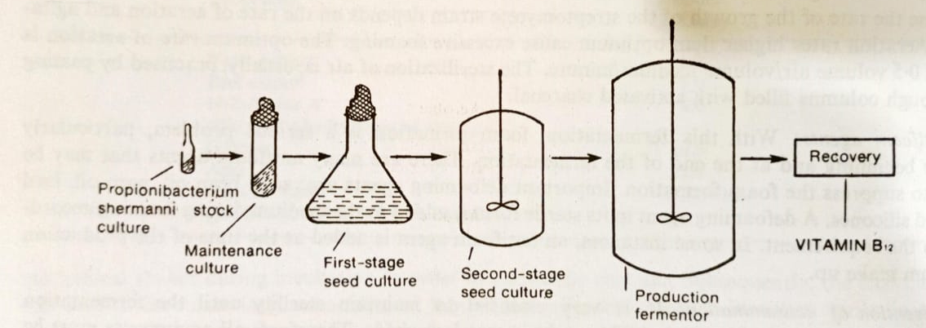
In a continuous culture version of the process, two large
fermentation tanks in series are used, each having a retention
period of 60 hours: the first is anaerobic and the second aerobic,
with 5, 6 dimethylbenziminazole added continuously. Thus, the
yield of 15 pg./ml. is obtained

Slide 35
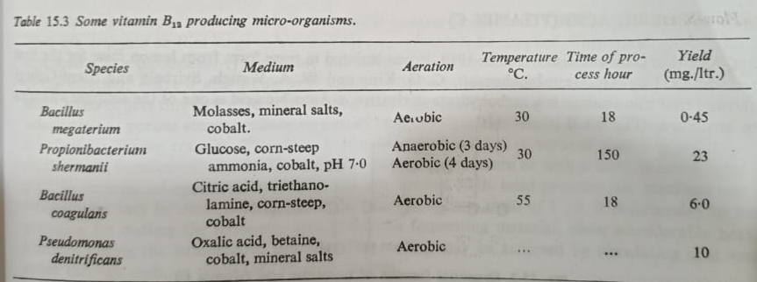
Vitamin B₁₂ production using other micro-organisms:
In addition to two above discussed micro-organisms,
Streptomyces olivaceus and Proplonibacterium freudenrechil, in
the industrial production of vitamin B₁₂ other commercially
important micro organisms with brief process details have been
listed in Table 15.3.
Japanese workers have reported that, various strains of
Corynebacterium, Mycobacterium and Nocardia can produce
vitamin B₁₂ on hydrocarbon media. But, the yields produced by
these microorganisms are poor, being in the order of a few
milligrammes per liter.

Slide 36
Fermentative production of Ethyl Alcohol
INTRODUCTION
Industrial solvents (e.g. ethanol, glycerol, acetone, butanol and
2, 3-butanediol) are widely used in chemical as well as
fermentation industries. For example, ethanol is used as a
solvent and a precursor of many synthetic chemicals.
On the other hand, extraction procedures of certain antibiotics
from fermented broth (e.g. penicillin) need suitable solvents.
These chemical compounds have been produced by
fermentation processes.
ETHYL ALCOHOL PRODUCTION
Alcohol fermentation was the first fermentation known to
mankind.
At first, alcohol was used only for human consumption. Later,
the demand for alcohol as a universal solvent and chemical
raw material developed. The distilling industry, therefore, grew
very rapidly..

Slide 37
The annual production in the United States alone has now
reached one billion gallons.
Micro-organisms: The micro-organisms responsible for alcoholic
fermentation of molasses are yeast species of Saccharomyces,
Torulopsis, Kloekera, Candida, and certain species of Mucor and
bacteria.
The most important among them are the yeast species belonging
to genus Saccharomyces. There are two types of Saccharomyces
species, one is a top fermenter and the other a bottom
fermenter.
Top fermenter yeasts (e.g. S. cerevisiae) are active at the top
surface of the fermenting liquid. They remain either in an evenly
distributed layer, or as a ring along the walls of the fermentation
vat.
Bottom fermenters (e.g. S. carlsbergensis) develop only at the
bottom of the fermentation vats. They are whirled up in the
liquid owing to carbon dioxide evolution.

Slide 38
The strain of yeast to be used for alcohol fermentation should possess the following selective features:
It should be an efficient strain. In other words it should produce
a large quantity of alcohol.
It should be a fast growing strain.
It should have a high tolerance to alcohol, as well as to osmotic pressure. The reason for this is that the yeast should continue its activities and accumulate large amounts of alcohol in a concentrated medium.
It should possess uniform and stable biochemical properties
Usually the strains of yeast, Saccharomyces cerevisiae, are employed for commercial production of ethyl alcohol. Special strains of this yeast have been developed for Industrial ethyl alcohol fermentation by genetic selection.
However, the choice of micro-organism depends upon the type of raw material to be used for alcohol fermentation.

Slide 39
Generally, strains of Saccharomyces cerevisiae are selected when starchy material, as well as saccharide material like molasses are used as raw material. Strains of Candida are preferred when whey and waste sulphite liquor are employed as raw material in alcohol fermentation.
Preparation of Inoculum:
A large amount of yeast culture is required in the industrial production of ethyl alcohol. The size of inoculum ranges from 8-10% with an average of 4% volume by volume.
The medium employed in the preparation of inoculum is the same as that of the actual fermentation process.
A high degree of aeration and agitation is necessary, since this favors rapid growth of yeast, producing a large amount of cell mass.
The optimum pH is 4.8 to 5. The optimum temperature is 28 to 30 ̊C.

Slide 40
Steps involved in the building up of inoculum are:
10 ml. of sterile medium in a test-tube is inoculated with pure yeast culture. The tube is incubated at 28° to 30°C. for a suitable period.
The tube culture is transferred to a flask, containing 200 ml. of sterile medium. The flask Incubated at 28° to 30°C. until pre-determined cell-mass is obtained.
The flask culture is, in turn, transferred to a suitable glass container, containing about 4 liters of sterile medium and incubated for an appropriate length of time.
Finally, the contents of the glass container are equally transferred into small tanks jest vessels) installed closely to a fermentor. Each small tank contains 10 to 40 gallons of sterile medium. After incubation the inoculum is ready for inoculating the fermentor. The inoculum is added to the fermentor by means of pumping or gravity. This operation of addition of
inoculum to the fermentation medium is called 'pitching'.

Slide 41
Raw Materials:
A variety of carbohydrates available as waste-products of agricultural industries are used for the preparation of fermentation medium. On the basis of their chemical nature, they may be grouped as:
Saccharide materials--molasses, hydrol, whey, technical glucose, fruit juices.
Starchy materials-potato starch, corn starch, wheat flour, cereals (e.g. oats).
Cellulosic material--sulphite waste liquor and others.
Preparation of Fermentation Medium:
The raw material used for the preparation of fermentation medium depends upon the agricultural produce of the country. For example, cane-molasses is used in India. Generally, molasses is used as the main raw material in the preparation of a fermentation medium.

Slide 42
However, starchy materials and cellulosic materials may also be
used for the preparation of fermentation medium. These
materials require treatment before their use. For example,
starchy material is subjected to saccharification, where starch
gets hydrolyzed, thus forming fermentable sugars, maltose and
glucose.
The optimum sugar concentration ranges between 10 to 18% in
the fermentation medium. Also, a suitable source of nitrogen,
such as ammonium sulphate, is added in optimum concentration.
When beet-molasses is used, usually a small quantity of black
strap molasses is also added to meet the biotin deficiency in the
beef-molasses.
The pH of the medium is adjusted to 4.8 to 5. The pH can be
adjusted by the use of H₂SO₄ or lactic acid. Alternatively, it can be
adjusted by growing lactic acid bacteria prior to fermentation.

Slide 43
It is not necessary to sterilize the fermentation medium. This is
mainly owing to highly acidic pH which hinders growth of
undesirable bacteria. However, pasteurization of the
fermentation medium may be practised.
Fermentation Conditions:
For the satisfactory progress and completion of the alcohol
fermentation, the following conditions are carefully controlled: Carbon Sources:
Sugar concentration in the range of 10 to 18% is found
satisfactory. Sugar concentration of 12% is often used. For
example, cane molasses contains sucrose (cane sugar) as a
carbon source. The sucrose content of this raw material is about
48 to 55 %.
Wort (molasses diluted with water) is prepared in such a way as
to contain about 10% sugars. High concentration affects yeast
adversely while low concentration makes the process
uneconomical.

Slide 44
Nitrogen Sources:
Many organic, as well as inorganic nitrogenous compounds may
be used in this fermentation. Ammonium sulphate (0.15 gms. per
2.5 gallons of molasses) is generally used with success to supply
nitrogen for growing yeast cells. The level of nitrogen in the
medium is limited. Excess nitrogen is objectionable, since it
promotes the growth of yeast, inhibiting the fermentation.
Growth Factors:
It is not necessary to add the growth factors separately in the
preparation of the fermentation medium, since the raw materials
(e.g. cane-molasses) used satisfy the requirements of the
culture.
pH:
pH of the fermentation medium is adjusted to 4.8 to 5. The
higher values of pH increase the chances of contamination,
whereas lower pH values inhibit the yield of ethyl alcohol.

Slide 45
Temperature:
Usually, the temperature range of 70° to 80 ° F. is preferred. As
there is heat evolution during fermentation, the temperature in
the fermentation tank rises gradually and is controlled by means
of cooling coils.
Temperature can also be controlled by cold water spray around
the fermentation tank.
Intermittent agitation is required for the uniform cooling of the
medium.
Higher temperatures favor the growth of bacteria and also cause
loss of ethyl alcohol due to evaporation.
Time:
Fermentation starts within a few hours after the addition of
yeast. The process becomes very rapid after 24 hours to
complete the fermentation.

Slide 46
Duration for ethyl alcohol fermentation is usually 30 to 72 hours
when the specific gravity of the fermented liquid (wash)
becomes constant. At this stage it contains 6 to 8% of ethyl
alcohol.
Yield:
On an average 0-4 gallons of ethyl alcohol is obtained from one
gallon of molasses. Strict technical control is essential to ensure
satisfactory yield.
About 90% of carbohydrate is converted into alcohol.
Recovery:
The fermented liquid (wash) is allowed to settle for a few hours,
and then, distilled in analyser and rectifier columns to obtain
rectified spirit (ethyl alcohol) and fusel oil (higher alcohol).
The highest concentration that can be secured by fractional
distillation is the constant boiling mixture. This mixture contains
95.6% ethyl alcohol and remaining 4.4% water.

Slide 47
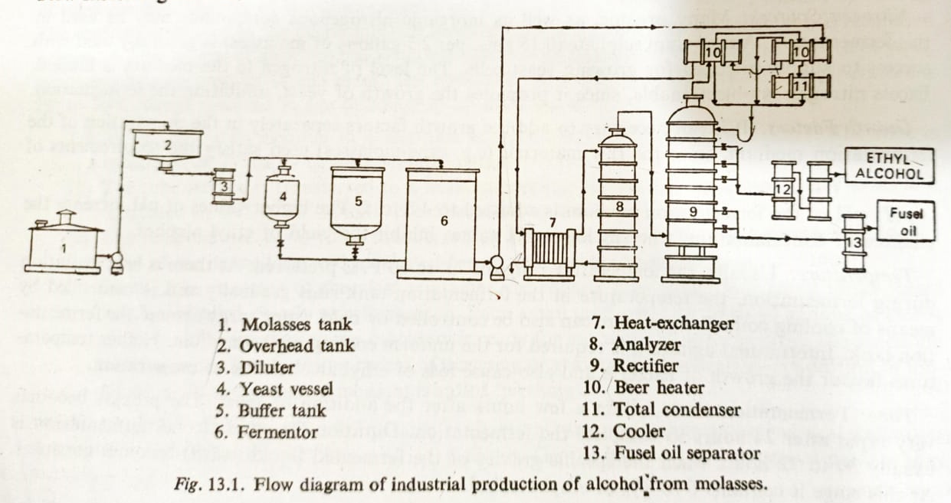
The spent wash and bottom sludge are drained as distillery
wastes. The product is marketed as rectified spirit,
denatured spirit, or special denatured spirit.
For the manufacture of rum, gin, whisky and brandy, matured
rectified spirit is used according to the ISI specifications.
Different techniques of ageing, dilution and blending are
employed for the manufacture of these potable deinks.

Slide 48
Bio-chemistry:
Alcohol fermentation is an anaerobic process (i.e. takes place in
the absence of air).
Micro-organisms utilize the carbohydrate present in the raw
material (e.g. molasses) to obtain energy for growth and
metabolic activities, leading to the formation of alcohol.
Monosaccharides (hexoses) are directly fermented.
Disaccharides are first hydrolyzed to hexoses, and then
fermented to form carbon dioxide and ethyl alcohol.
The flow of carbon in the ethyl alcohol formation takes place via
the well known Embden-Meyerhof- Parnas (EMP) pathway:
C₆H₁₂O₆ 2CH₂CH₂OH + 2CO₂
A series of intermediate steps involving enzymes result in the
breakdown of glucose molecules into pyruvic acid. The pyruvic
acid is then further converted into ethyl alcohol and carbon
dioxide by the fallowing enzymatic reactions.

Slide 49
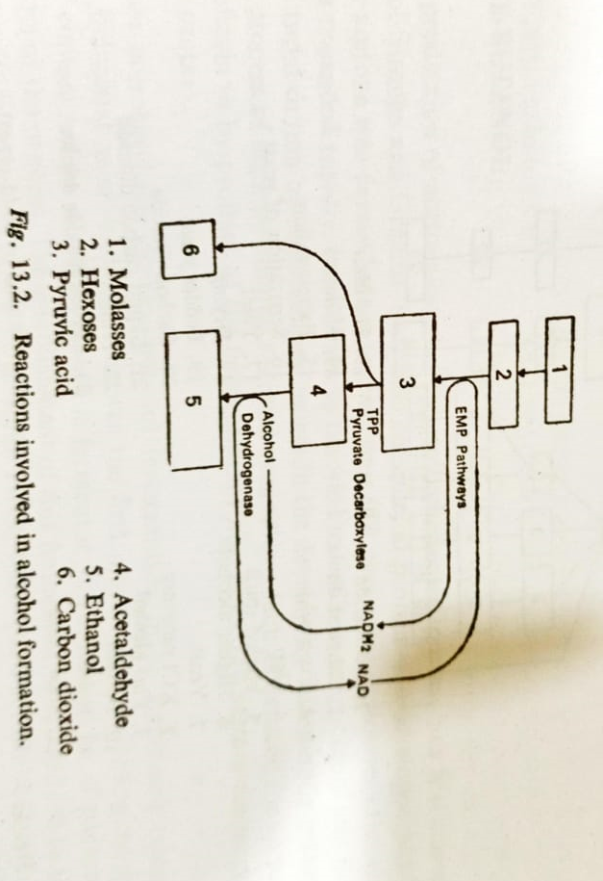
The enzyme decarboxylase catalyses the decarboxylation of
pyruvic acid to acetaldehyde.
CH₃COCOOH pyruvate decarboxylase CH₃CHO + CO₂
The enzyme alcohol dehydrogenase further catalyses the reduction of acetaldehyde to ethyl alcohol at the expense of NADH₂ :
CH₂ CHO + NADH₂ Alcohol dehydrogenase CH₃CH₂OH + NAD.

Slide 50
by products:
The three main by-products of the alcohol industry are: carbon
dioxide, the yeast and the distillery effluent. Carbon dioxide is
produced in large quantities. This gas after purification can be
liquefied or converted into dry ice.
The latter finds wide commercial use. For example, large
quantities of liquefied carbon dioxide are used in the soft drink
industry.
The yeast withdrawn from alcoholic mash is a valuable fodder
due to its higher content of proteins, vitamins and essential
trace elements.
During the production of alcohol some quantities of higher
alcohols (isoamyl alcohol, butyl alcohol), collectively called fusel
oil, are also formed. After refining they are used in small
quantities in the manufacture of perfumes and potable liquors,
and the bulk portion is processed into various acetates by
esterification.

Slide 51
Among them n-propyl acetate, isopropyl acetate and amyl
acetate are mainly used in the paint and lacquer industry.
Distillery-spent wash or effluent is a good source of potassium
salts and can be used for the manufacture of potassium fertilizer.
The main product, alcohol, offers many possibilities for further
processing, besides its use for drinking purposes.
The most important industrial uses of alcohol are in the
manufacture of ether, acetaldehyde, butanol, etc.

Slide 52
Fermentative production of Penicillin (Secondary metabolite)
Introduction
Penicillin was described by Fleming in 1929. A research group at
Oxford under Florey and Chain isolated it from surface cultures
of Penicillium notatum in 1940 and the first clinical application of
penicillin was in 1941.
Penicillins are produced by many fungi particularly Penicillium
and Aspergillus species.
Natural penicillins are effective against numerous gram-positive
bacteria. They are labile in acid and may be inactivated by
splitting the B-lactam ring with penicillin-b-lactamases.
Because of its low toxicity, large doses of penicillin can be used;
only a small percentage of patients develops allergies (0.5-2%).
B-Lactam antibiotics are specific inhibitors of bacterial cell wall
(peptidoglycan) synthesis.

Slide 53
They combine specifically with the so-called penicillin-binding
protein (PBP) of the bacterial cell and, by inhibiting the enzyme
activity of this protein, bring about cell death.
In E. coli it has been shown that PBP1a and 1b are
transpeptidases involved in the cross-linking of the peptidoglycan. Chemical structure
The basic structure of the penicillins is 6-aminopenicillanic acid (6-
APA), which consists of a thiazolidine ring with a condensed B-
lactam ring.
The 6-APA carries a variable acyl moiety in position 6, as illustrated
in Figure. If the penicillin fermentation is carried out without
addition of side-chain precursors, the natural penicillins are
produced. From this mixture, only benzylpenicillin is therapeu
tically useful; the other compounds must be removed at the
product recovery stage.

Slide 54
The fermentation can be better controlled by adding a side-chain
precursor, so that only one desired penicillin is produced.
Over 100 biosynthetic penicillins have been produced in this way.
In commercial processes, however, only penicillin G, penicillin V,
and very limited amounts of penicillin O have been produced.
In order to produce semisynthetic penicillins, penicillin G (some-
times penicillin V is used instead) is chemically or enzymatically
split to form 6-APA, which is chemically recycled to make yet
another penicillin derivative.
Due their improved characteristics (acid stability, resistance to
plasmid or chromosomally coded B- lactamases, expanded
antimicrobial effectiveness), semisynthetic penicillins have come
to be extensively used in therapy.
About 38% of the penicillins produced commercially are used in
human medicine, 12% in veterinary medicine, and 43% are used
as starting materials for the production of semisynthetic
penicillins.

Slide 55
In the early 1980's, world-wide production of penicillins
amounted to 12,000 tons, an exceedingly large amount
considering how highly active these agents are.
Biosynthesis and regulation
The B-lactam-thia zolidine ring of penicillin is constructed from L
cysteine and L-valine.
Biosynthesis occurs in a non ribosomal process by means of a
dipeptide composed of L-α- aminoadipic acid (L- α -AAA) and L-
cysteine or a breakdown product of cystathionine.
Subsequently, L-valine is connected via an epimerization
reaction, resulting in the formation of the tripeptide δ-(L- α -
aminoadipyl)- cysteinyl-D-valine.
The first product of the cyclization of the tripeptide which can be
isolated is isopenicillin N, but the biochemical reactions leading
to this intermediate are not understood. Benzylpenicillin is
produced in the exchange of L- α -AAA with activated
phenylacetic acid.

Slide 56
6-APA, which is not an intermediary product of biosynthesis, is
excreted in the absence of a side chain precursor.
Several regulatory mechanisms are known in penicillin
biosynthesis. The amino acid lysine is synthesized from a
pathway that involves L- α- aminoadipic acid, so that penicillin
and lysine share a common branched biosynthetic pathway.
Lysine inhibits penicillin synthesis because it is a feedback
inhibitor of homocitrate synthase, an enzyme involved in L- α –
AAA synthesis. If L- α- AAA is deficient, penicillin cannot be
synthesized. However, feedback regulation by lysine does not
seem to be a rate-limiting step in penicillin biosynthesis.
Penicillin biosynthesis is affected by phosphate concentration and
also shows a distinct catabolite repression by glucose, in addition
to a regulation by concentration of ammonium ion, the latter by
an unexplained mechanism.

Slide 57
Strain development
The penicillin production of Fleming's isolate was about 2
International units/ml; today's processes yield a penicillin titer of
about 85,000 units/ml. This is an increase from 0.0012 g/l to
about 50 g/1 and well illus traits the value and power of a strain-
selection program.
The initial culture improvement came in 1943 with the isolation
of Penicillium chrysogenum strain NRRL 1951, This organism was
better suited for submerged production than the original
P. notatum strain. Through further mutagenesis, strain Wis Q 176
was isolated, Wis Q 176 was adopted by most penicillin
manufacturers and was used as the original strain for the various
commercial strain improvement programs, about which little has
been published.

Slide 58
Yield increases have been the main objective of strain
development, but other factors which have an effect on
fermentation and efficiency of product recovery have also been
optimized.
Until the mid 1960's, the most frequently used mutagens were X-
rays, methylbis-(8-chloroethyl)amine (nitro gen mustard), and
short-wave ultraviolet radiation.
More recently, nitrosoguanidine, alkylating agents, and nitrite
have been used as mutagens.
The discovery of a parasexual cycle in P. chrysogenum provided a
means of utilizing genetic recombination for strain development.
The protoplast fusion technique has opened up a new approach
to the development of high yielding strains. Yield increases of 8%
have been obtained over those obtained by mutation and
selection.

Slide 59
Production methods.
Penicillin G and V are produced using submerged processes in
40,000 - 200,000 liter fermenters. Due to difficulties with the O₂
supply, larger tanks cannot be employed.
Penicillin fermentation is an aerobic process with a volumetric
oxygen absorption rate of 0.4-0.8 mM/min. The required
aeration rate is between 0.5-1.0 vvm depending on the strain, on
the bioreactor, and on the impeller system; various turbine
impellers are used for mixing (120-150 rpm).
The optimal temperature range is between 25-27°C.
The inoculum is started using lyophilized spores. Because of the
great variability of high- yielding strains, careful strain
maintenance is necessary. Spore concentration (optimal 5X10³/ml)
and pellet formation are crucial for the sub sequent yield.
If an optimal penicillin formation rate is to be achieved, pellets
must grow not as compact balls, but in a loose form.

Slide 60
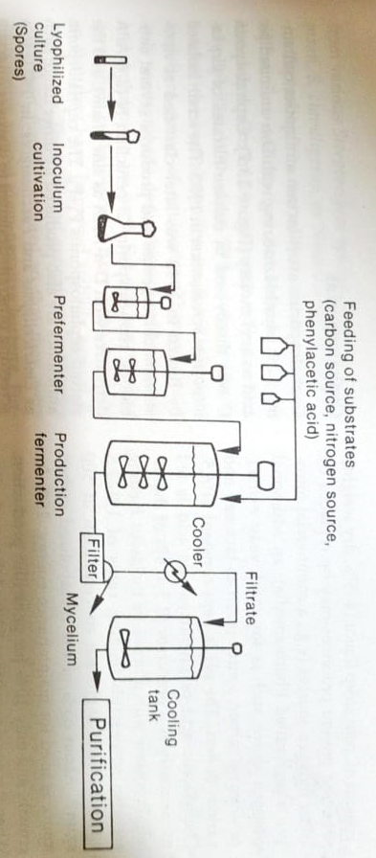
A typical flow chart for penicillin production is shown in Figure.
After several stages of growth the production culture is ready.
there is a growth phase of about 40 hours duration, with a
doubling time of 6 hours, during which time the greatest part of
the cell mass is formed.

Slide 61
The oxygen supply in the growing culture is critical, since the in
creasing viscosity hinders oxygen transfer. This can be resolved
by engineering changes in the fermenter or by the use of
mutants which develop reduced viscosity.
After the growth phase the culture proceeds to the actual
penicillin production phase. In cases of high penicillin production,
growth is sharply reduced (µ= 0.01 h⁻¹).
By feeding with various culture medium components, the
production phase can be extended to 120-180 hours.
The medium of a typical fed-batch culture may vary depending
on the strain and usually consists of: corn steep liquor (4-5%, dry
weight), which in present processes may be replaced by other
nitrogen sources (e.g., a commercial nitrogen source called
Pharmamedia); an additional nitrogen source, such as soy meal,
yeast extract, or wheys a carbon source (such as lactose); and
various buffers.

Slide 62
The pH is kept constant at 6.5. Phenylacetic acid or phenoxyacetic
acid is fed continuously as a precursor (0.5-0.8% of the total).
Processes with glucose or molasses feeding are also successful.
Yield increases of 25% have been reported by adding glucose and
acetic acid.
Critical parameters in these fed batch systems are the rate of
sugar utilization and the oxygen supply.
Production with continuous penicillin fermentation has been
attempted, but has been difficult due to the instability of the
production strains.
A "batch fill and draw" system has been suggested as an
alternative.
In this procedure, 20-40% of the fermentation contents is drawn
off and replaced with fresh nutrient solution; this process may be
repeated up to 10 times without yield reductions.

Slide 63
Extensive research is being carried out to pro duce penicillin with
immobilized cells.
In one laboratory-scale study, the advantage of this ap proach
over the use of a fed-batch system was demonstrated, but this
technique has not as yet been introduced commercially.
Recovery
Penicillin is excreted into the medium and less than 1% remains
mycelium-bound.
After separation of the mycelium, product recovery is
accomplished by means of a two-stage continuous
countercurrent extraction of the fermenter broth with amyl or
butyl acetate at 0-3°C and pH 2.5-3.0. The yield is around 90%.

Slide 64
Fermentative production of α - Amylase
Starch, a glucose polymer, is one of the most widely available plant polysaccharides. Amy lases are enzymes which hydrolyze starch. One of the main uses of amylases is in the production of sweeteners for the food industry. hy drolysis of starch with amylase results first in the production of short-chain polymers called dex trins, then the disaccharide maltose, and finally glucose. Maltose syrup (>80% maltose), which is produced primarily in Japan, is of low viscosity, is weakly hygroscopic, not crystallizable, only slightly sweet, but has good heat stability and does not undergo browning reactions. Glucose is not nearly as sweet as its isomer fructose, so the next step is the conversion of glucose to fructose using the enzyme glucose isomerase (discussed in Section 11.3). Commercial sweeteners based on fructose have some economic and manufac turing advantages over the more widely used

Slide 65
sweetener sucrose. The most important enzymes in the starch-saccharification process are a-amy lases, 8-amylases, glucoamylases, glucose iso merases, pullulanases, and isoamylases. Figure 11.3 shows the manner of action of these en zymes on starch.a-Amylasesa-Amylases (1,4-a-glucan-glucanohydrolases) are extracellular enzymes which hydrolyze a 1,4-glycosidic bonds. These enzymes are en doenzymes, splitting the substrate in the interior of the molecule. Their action is not inhibited by a-1,6-glycosidic bonds although such bonds are not splita-Amylases are formed by many bacteria and fungi. They are classified according to their starch-liquefying and/or saccharogenic effect, pH optimum, temperature range, and stability Saccharogenic amylases produce free sugars, whereas starch-liquefying amylases break down the starch polymer but do not produce free sug ars. Many organisms produce several a-amy- lases.Bacteria which produce a-amylases are: Ba cillus subtilis, B. cereus, B. amyloliquefaciens, B.

Slide 66
coagulans, B. polymyxa, B. stearothermophilus, B. caldolyticus, B. acidocaldarius, B. subtilis var. amy losaccharaticus, B. licheniformis, Lactobacillus, Mi crococcus, Pseudomonas, Arthrobacter, Escherichia, Proteus, Thermomonospora, and Serratia.Three very similar strains producing sac charogenic a-amylases are B. subtilis Marburg, B. subtilis var. amylosaccharaticus, and B. natto. The strain B. amyloliquefaciens differs from these in that it produces a liquefying a-amylase. The sub strate concentration determines the extent to which the enzymes act in a liquefying or sac charogenic manner.Some a-amylase-producing fungi are from the genera Aspergillus, Penicillium, Cephalospo rium, Mucor, Candida, Neurospora, and Rhizopus.The molecular weights of various a-amylases do not differ considerably (Table 11.3). They all contain a large proportion of tyrosine and tryp

Slide 67
Fogarty, 1983)tophan in the enzyme protein and most require calcium as a stabilizer.The most important a-amylases are produced by Bacillus amyloliquefaciens, Bacillus lichenifor.. mis, and Aspergillus oryzae, Bacillus amylases a used much more extensively than those of As pergillus. The most important areas of application for these two enzymes are shown in Table 114Production of bacterial a-amylases Bacterial am ylase production involves the function of the nor mal cell machinery for protein synthesis. This is shown by experiments involving the addition of antibiotics. If the specific antibiotics are used to inhibit protein synthesis in B. subtilis during the production of a-amylases, both growth and pro duction of amylase cease (Figure 11.4). Com pared to the mRNA of intracellular enzymes (sta- bility about 2 minutes for Escherichia coli), the mRNA for the production of extracellular hydro lases has an extremely long lifetime. When ac tinomycin D is added to the amylase-producing culture to inhibit RNA synthesis, both RNA syn- thesis and growth cease after 30 minutes but the

Slide 68
[09:22, 12/30/2020] shaikh sajid: roduction of amylase continues (Figure 11.5). For industrial production, a-amylases are produced either in batch or in fed-batch fermen tation. The enzyme formation rate is very low during exponential growth in many production strains, but just before the growth rate decreases and spore formation begins, amylase production increases (Figure 11.6).The production of a-amylases is regulated by several genes, which have been only partially[09:22, 12/30/2020] shaikh sajid: characterized. Whereas single-step mutations in crease yields by a factor of 2-7, mutants have been selected after 5 steps which produce yields 250 times greater than the wild strain. [09:22, 12/30/2020] shaikh sajid: Since starch is a macromolecule, it cannot be taken up by the cells and hence cannot act as an inducer of a-amylase synthesis.

Slide 69
It is assumed that a small amount of enzyme is produced consti[09:23, 12/30/2020] shaikh sajid: tutively and excreted into the medium where its action on starch leads to the production of low molecular-weight inducers. Catabolite repres sion is significant in the production of most ex. tracellular enzymes. Glucose promotes the best growth compared to other substrates, but is the least favorable in terms of amylase production. In continuous fermentation with carbohydrate as a limiting factor, growth is inversely proportional to the a-amylase production. When nitrogen is used as a limiting factor with excess glucose, only traces of amylase are produced.

Slide 70
[09:23, 12/30/2020] shaikh sajid: It seems unlikely that amylase is excreted by pure diffusion, since the molecule is quite large and is hydrophilic. There is good evidence that the biosynthesis as well as the steps leading to excretion of extracellular proteins such as amy lases and proteases takes place at the outer mem brane of the cell. As it is formed, the protein contains an additional peptide, the signal peptide, which participates in the transfer of the nascent protein from the ribosome through the mem brane. Only after the protein has passed through the membrane does it fold into its tertiary configuration and the signal peptide is removed. A medium for the production of a-amylases in a 100 m fermenter with B. subtilis consists of: 5% starch, 0.56% NH.NO,, 0.28% sodium cit rate, 0.13% KH,PO., 0.05% MgSO, 7 H,O.[09:25, 12/30/2020] shaikh sajid: 0.01% CaCl, 2 H,O, 0.5% peptone, 0.2% yeast extract: pH 6.8. The effect of temperature on enzyme production and growth rate is given in Figure 11.7.

Slide 71
At 45°C, the maximal specific enzyme formation rate is reached with the test strain after 18 hours: however, the maximal amount of enzyme pro duced (up to 3000 units/ml) is obtained at con siderably lower temperatures (27 to 30°C). Ther mophilic strains are used in newer process Thermomonospora, isolated from compost, has a temperature optimum for growth and amylase production at 53°C. Figure 11.8 shows the nar row pH optimum for amylase production by this strain.a-Amylase production from fungi The production of fungal amylases is constitutive, but as with other enzymes, it is repressed by regulators. For amylase production using Aspergillus oryzae, the following nutrient solution can be used: 8% starch, 1.2% NaNO,, 0.1% K,HPO, 0.1% MgSO,, 0.05% KCI, 0.003% FeSO, 0.08% Mg(NO,), 0.05% Mg(H,PO,), 2.0% malt extract. The medium composition must be optimized, be cause as seen in Table 11.5, a marked shift in enzymatic activities is observed when different carbohydrates are used.The optimal temperature lies in a narrow range between 28-30°C, and the duration of the fermentation process is 3-4 days.

Slide 72
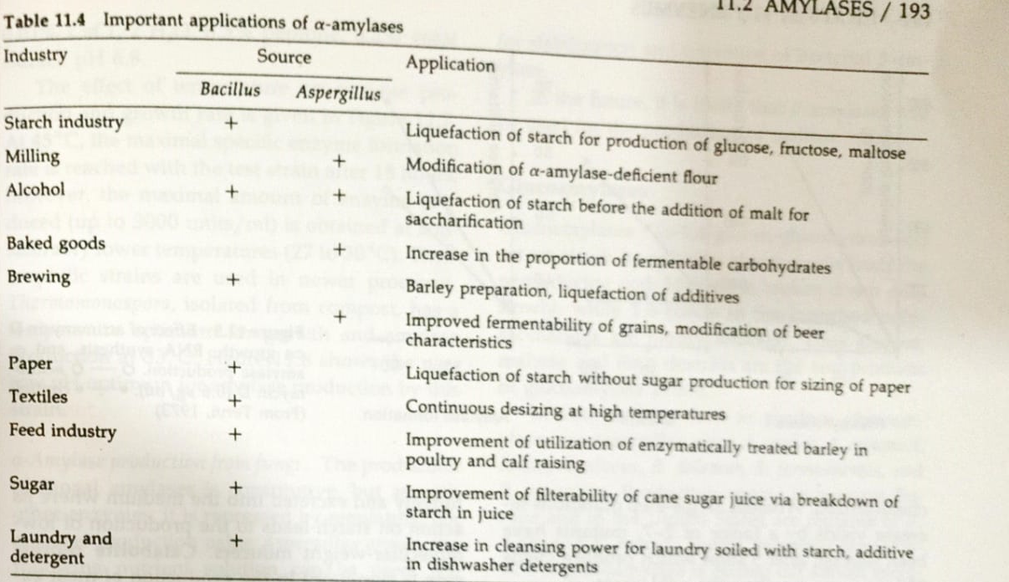

Slide 73
Fermentative production of Yoghurt or Bulgarian Milk
Introduction:
Yoghurt is a diary product prepared by the fermentation of milk.
It is consumed in large quantities as a food item by the Bulgarian
people. Nowadays is also consumed by the people of Europe and
North America.
According to the Russian bacteriologist Metchnikov, E. (1908),
growth of Lactobacillus bulgaricus in the colon produced a high
concentration of lactic acid. This highly acidic environment did
not permit the growth of proteolytic flora. Therefore, disorders
that were supposedly connected with adsorption of proteolytic
wastes from the alimentary tract would not occur.
It is believed that if a man regularly consumes 250 to 600 gms. of
yoghurt daily from his childhood, he can expect to lead a healthy,
buoyant and youthful life upto the age of 70 to 80 years.

Slide 74
It also lowers the blood cholesterol level and, therefore, improves
the functioning of the cardio-vascular system making the heart
strong. Today, therapeutic, prophylactic and nutritional
properties of dahi are widely accepted.
Manufacture of Yoghurt:
Yoghurt is commercially manufactured by the fermentation of
milk with two thermophilic bacteria, viz., Streptococcus
thermophilus and Lactobacillus bulgaricus.
The latter rapidly grows at optimum temperature through the
process of symbiosis. The final product is highly viscous, slightly
sour, with its characteristic 'curd' flavour and odour.
It has consistency resembling custard.

Slide 75
The essential features of all the methods of production of
yoghurt are:
Selection of milk.
Standardization (fat extracted)-milk
Warming and homogenisation. powder of concentrated milk added.
Heat treatment (steaming for half an hour).
Cooling to about 50°C.
Inoculation with yoghurt cultures.
Packaging.
Incubation in a warm room (42° to 44°C.).
Cooling in the air.
Cold storage.

Slide 76
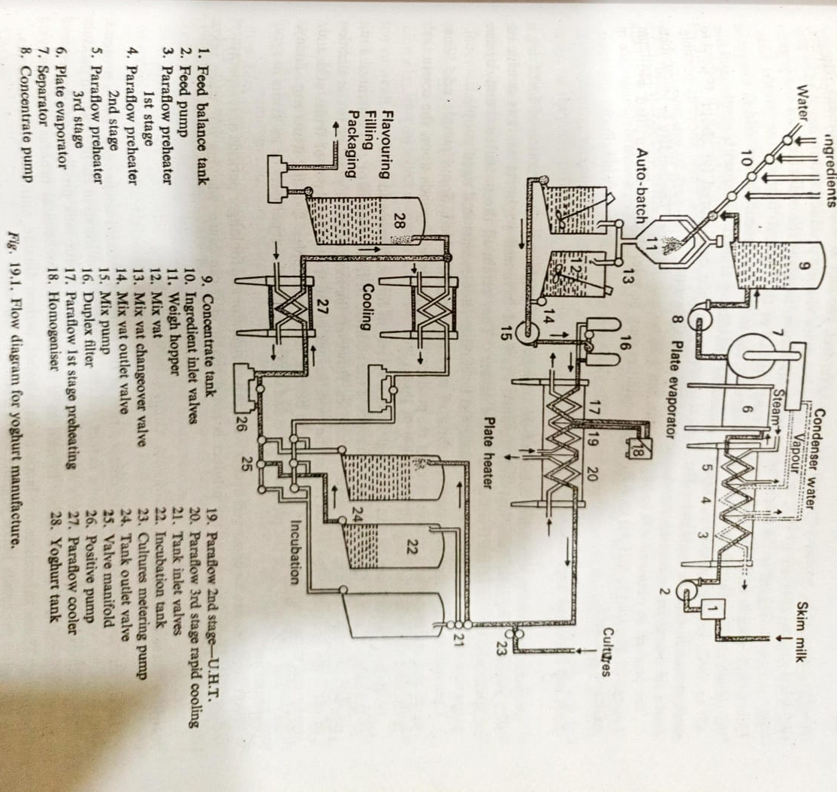

Slide 77
The alternate steps are:
Incubation,
Cooling,
Agitation and
Packaging.
The variations in commercial practices in the manufacture are
related to two aspects only.
They are:
(1) Standardization of milk in respect of fat and solids-not-fat(SNF)
(2) the stage of packaging the product.
Yoghurt contains 2% to 3% of fat, but even a fat-free product is
acceptable to many. Usually, the SNF content is raised to 14% to
16% to make it a more viscous product and to increase its
protein content.

Slide 78
In regard to the second aspect, the modification involves the
marketing of the yoghurt as a highly viscous uniform product
'stirred curd' instead of the normal 'firm-set' or junket form'.
As shown above, as an alternate step of manufacture, the milk
after inoculation is held in the vat at 42° to 44°C. Until it
coagulates, then it is cooled by circulating chilled water with
gentle agitation and packed in suitable containers.
The filled containers are then cold stored (at about 5 to 6°C)
and held overnight to develop the characteristic 'Yoghurt'
flavour.
The product so obtained will be slightly sour, but with a clean
flavour. The acidity is about 0.9 % but can go upto 1.1% (pH 4-0
to 4-2). Higher acidities may be tolerated if milk fortified with
extra milk solids is used.

Slide 79
Fruit and Flavoured Yoghurts
A recent innovation which has enhanced the popularity of
yoghurt is the practice of fortifying it with sweetening agents,
fruits and fruit flavors.
Fruit and flavored yoghurts are sweet with the characteristic
flavor of the fruits or the added flavors.
They retain all the nutritional and curative properties of yoghurt.
They are readily accepted by children, adolescents and aged
people.
Common sugar is the most common form of sweetening agent
added. Some people add honey which also increases the
nutritive value of the product.
The sugar level depends upon the consumer's preference and is
in the range of 6% to 8% as sucrose. Fruits and flavors can be
added to yoghurt in a variety forms.

Slide 80
Some add synthetic flavors not to the liking of many. Quite a
common practice is the addition of fruit extracts or concentrates.
Fruit powders are also added in some western countries.
However, the most popular practice is the addition of cut fruits
or fruit pulps which retain the fresh flavour of the fruit. The types
of fruits added are many and variable.
The popular fruits are the berries, citrus and apples. Usually,
fruits are added at the rate of 15% to 20% of the product.
Fruits and sugar may be added separately or as 'fruits in syrup
preparations'.
Fruit yoghurts can be preserved upto a week in a refrigerator and
for longer periods at temperatures below 5°C.
Deep freezing of the product is not desirable as it can cause
'wheying off' when taken out for thawing.

Slide 81
Nutritive Value of Yoghurt
During fermentation of milk, the composition of the minerals
remains unchanged, while proteins, carbohydrates, vitamins, and
to some extent, fat constituents are subjected to changes which
produce special physiological effects.
Dietary and therapeutic qualities of sour milk products are
determined by micro-organisms and substances formed as a
result of the biochemical process accompanying milk souring.
These substances are lactic acids, alcohol, carbon dioxide,
antibiotics and vitamins.
The following processes make yoghurt more nutritive than milk:
Proteolysis in milk:
Proteolysis in milk takes place by exo- or endo-peptidase of lactic
acid bacteria. The biological value of protein increases
significantly during yoghurt manufacture from a value of 85.4% to
90%. This increase is due to breakdown of protein into peptones,
peptides and amino acids.

Slide 82
The contents of essential amino acids such as leucine, isoleucine,
methionine, phenylalanine, tyrosine, threonine, tryptophane and
valine increase considerably, which offer special advantages not
only to healthy people but also particularly to the physically
weak.
Hydrolysis of lactose:
Lactose in milk is hydrolyzed by metabolic activity of bacteria.
Approximate 2-5% lactose, 0-8% to 1-3% galactose and 0.03%
glucose are obtained from lactose hydrolysis.
Lactose hydrolysis takes place due to B-galactosidase production
by lactic acid bacteria.
The importance of lactose is due to the lactic acid produced from
the hydrolysis of lactose, which leads to a pH range in the bowel
inhibiting the growth of putrefactants.
In addition to this, lactic acid is important for organoleptic
properties and calcium absorption.

Slide 83
Lipolysis:
The homogenization process reduces the size of fat globules
which become digestible.
The production of free fatty acids as a consequence of lipolytic
activity increases as compared to milk. This leads to some
physiological effects.
Changes in Vitamins:
There is more than a two-fold increase in vitamins of B-group,
especially thiamine, riboflavin and nicotinamide as a result of the
biosynthetic process during milk fermentation.
Subsequently, vitamin Bs, vitamin C and vitamin B1 (thiamine)
decrease by approximately one half only, as they are utilized by
the bacteria in milk.

Slide 84
Antibacterial activities:
The bactericidal properties of sour products are determined by
the antibiotic activity of the bacteria growing in the product.
The antibiotic properties are generally associated with
lactobacilli in yoghurt, and materials responsible for such
antibacterial action are described as lactic acid, hydrogen
peroxide and other substances such as lactobacilline, etc.
Therapeutic Importance:
The main advantages of regular intake of yoghurt are:
This product is easily absorbed and better assimilated than
sweet whole milk. Assimilation of milk is 32% in one hour, while that of yoghurt it is 91% in the same period.
(2) Yoghurt improves appetite due to its pleasant, refreshing and pungent taste. It is highly nourishing and invigorating not only to healthy persons but also to the ill and infirm.

Slide 85
Gastric juice secreted by the action of yoghurt and the
desirable ratio of calcium and phosphorous induced by it leads to a high digestive capability.
(4) Yoghurt consists of a sufficient amount of indispensable amino acid, methionine, which removes excessive fat from the liver and enhances bile secretion. It is, therefore, an important therapeutic adjuant in gastrointestinal disturbances, hepatitis, nephritis, diarrhoea, colitis, anaemia and anorexia. It provides wonderful relief to patients of chronic diarrhoea, sprue and ulcerative colitis. Fat-free yoghurt is necessary for those who suffer from heart disease, arteriosclerosis, hypertension and chronic inflammation of the liver.

Slide 86
Yoghurt possesses potent antitumor activity according to
Shahani, professor of Food Sciences at the University of Nebraska, U.S.A. It may prevent or retard the onset of diseases. Pathogenic bacteria are not able to survive in it because of its low pH and other adverse factors for their growth. Consumption of less than one liter of yoghurt per day will not affect human health adversely, but more may involve the risk of acidosis. The nutritional and therapeutic effects of yoghurt do not depend on living bacteria but on their metabolites.

Slide 87
Biotransformation: Steroid Transformation
Microbial transformations or biotransformation, are minor
changes in molecules, such as the insertion of a hydroxyl or keto
function or the saturation/desaturation of complex cyclic
structure, that are carried out by non-growing microorganisms.
The microorganisms thus act as biocatalysts. Bioconversions
have many advantages over chemical procedures.
A major advantage is stereochemical; the biologically active form
of a product is made.
In contrast, most chemical syntheses produce racemic mixtures in
which only one of the two isomers will be able to be used
efficiently by the organism.
One among such transformations is the steroid transformation in
which microorganisms can carry out chemical transformations.
These steroids are organic molecules and are related to sterols;
abundant in nature e.g. cholesterol (found in brain and nerve
tissue) and ergosterols (in yeast).

Slide 88
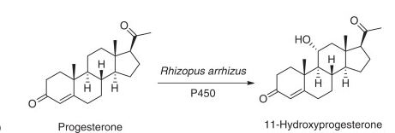
Various steroid hormones are utilized as regulators of
metabolism in the animals or human body and it was discovered
that cortisone and its derivative such as progesterone are
effective in the treatment of rheumatoid arthritis.
A typical bioconversion is the hydroxylation of a steroid.

Slide 89
It was observed then when a culture of the genus Rhizopus was
grown using progesterone as a substrate; it was found that
progesterone was unexpectedly converted to 11α-Hydroxyl
progesterone.
In this example, the water-insoluble steroid is dissolved in
acetone and then added to the reaction system that contains the
pre grown microbial cells. The course of the modification is
monitored, and the final product is extracted from the medium
and purified.
Similar reactions can proceed with apparent case when mediated
by microorganism. In which certain microorganisms can
introduce hydroxyl groups at any of the several carbon of the
steroid molecule.
One such example is the utilization of Curvularia lunata to
introduce a hydroxyl group at 11th carbon position to yield
hydrocortisone carbon 11 of steroid nucleus.

Slide 90
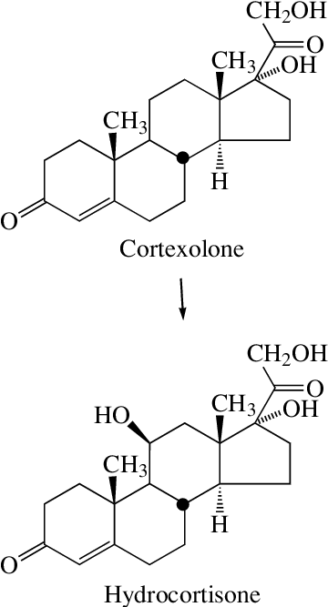
This particular interest since oxygen atom required for biological activity is used in the treatment of rheumatoid arthritis.

Slide 91
Microbial preparations of many steroids by their enzyme action
at the specific site lead to the synthesis of novel varieties of
steroids.
Such processes are more stable and specific steroid
transformation is different with that of microbiological process
due to the fact that in later organic acids, solvents and antibiotics
are synthesized from the medium which serves as a substrate for
the growth and reproduction of microorganisms.
Organism involved in steroid bioconversion includes several fungi
such as Rhizopus nigricans, Curvulara lanata, Aspergillus spp.,
Pencillium spp., Fusarium salam ,Yeast and bacteria namely
Corynebacterium spp. are known for bio-transformations

Slide 92
Industrial Production
Cells can be produced in batch or continuous culture and then
dried for direct use or they can be prepared in more specific
ways to carry out desired bioconversions.
The steroid transformations are carried out in stainless steel
aerated fermenters.
The selection of organism is made in such a way to get maximum
growth in a short period of time.
Generally glucose or sucrose is used as carbon source and corn
steep liquor as nitrogen Source.
The steroid substances are not water-soluble and therefore are
dissolved in water miscible solvent such as ethanol, acetone or
propylene. which are non toxic to the microorganism.
After the addition to the medium the steroid substances become
colloidal and are dispersed throughout the medium, which is
added at low concentration to the fermentation medium.

Slide 93
The steroid transformation is analyzed chromatographically using
TLC by periodic sampling from the culture broth.
The fermentation lasts for about 24-48 hours. The transformed
steroid is harvested from the culture broth and is purified by
solvent extraction process.

Slide 94
Recombinant Product: Insulin
Insulin Production (Humulin)
Insulin was the first hormone identified (late 1920s) by (Banting
and Best). They are the doctor and medical student who won
Nobel Prize.
like many hormones, insulin is a protein. Insulin is secreted by
groups of cells within the pancrease called islet cells.
Insulin causes most of the body's cells to take up glucose from
the blood (including liver, muscle, and fat tissue cells) storing it as
glycogen in the liver and muscle and stops use of fat as an energy
source. When insulin is absent (or low) glucose is not taken up by
most body cells and the body begins to use fat as an energy
source (i.e. transfer of lipids from adipose tissue to the liver for
mobilization as an energy source).
As its level is a central metabolic control mechanism, its status is
also used as a control signal to other body systems (such as amino
acid uptake by body cells).

Slide 95
It has several other anabolic effects throughout the body. When
control of insulin levels fails, diabetes mellitus results.
Type 1 diabetics who do not make insulin can become very ill
without insulin shots. Those who develop a deficiency of insulin
must have it replaced via shots or pump (Type I Diabetes).
More commonly, people will develop insulin resistance (Type 2
Diabetes rather than a true deficiency of insulin. In this case, the
levels of insulin in the blood are similar or even a little higher
than in normal, non-diabetic individuals.
However, many cells of Type 2 diabetics respond sluggishly to the
insulin they make and therefore their cells cannot absorb the
sugar molecules well, this leads to blood sugar.
Insulin is a peptide hormone composed of 51 amino acid residues
and has a molecular weight of 5808 Dalton. hormone composed
Insulin's structure varies slightly between species of animal.

Slide 96
Insulin from animal source: differs somewhat in 'strength' (i.e. in
carbohydrate metabolism control effects) in human because of
those variations. Porcine (pig) insulin is especially close to the
human version.
Insulin Commercial Production
The first successful insulin preparations came from cows (and
later pigs). The pancreatic islets and the insulin protein contained
within them were isolated from animals slaughtered for food.
The bovine (cow) and porcine (pig) insulin were purified, bottled,
and sold.
Bovine and porcine insulin could develop an allergy or other
types of reactions to the foreign protein (a foreign protein is a
protein which is not native to humans for some patients).

Slide 97
Production of Human Insulin (Humulin)
In the 1980's technology had advanced to the point where we
could make human insulin. The advantage would be that human
insulin would have a much lower chance of inducing a reaction
because it is not a foreign protein.
The technology, which made the approach possible, was the
development of recombinant DNA techniques.
In simple terms the human gene, which codes for the insulin
protein was cloned (copied) and then put inside of bacteria.
Human insulin is the only animal protein to have been made in
bacteria in such a way that its structure is absolutely identical to
that of the natural molecule.
This reduces the possibility of complications resulting from
antibody production.
In chemical and pharmacological studies, commercially available
Recombinant DNA human insulin has proven indistinguishable
from pancreatic human insulin.

Slide 98
Manufacturing Humulin
The first step is to chemically synthesize the DNA chains that
carry the special nucleotide sequences characterizing the A and B
polypeptide chains of insulin.
The required DNA sequence can be determined because the
amino acid compositions of both chains have been charted.
Sixty-three nucleotides are required for synthesizing the A chain
and ninety for the B chain, plus a codon at the end of each chain,
signaling the termination of protein synthesis.
An anti-codon, incorporating the amino acid methionine, is then
placed at the beginning of each chain, which allows the removal
of the insulin protein from the bacterial cell's amino acids.
The synthetic A and B chart genes' are then separately inserted
into the gene for a bacterial enzyme, B-galactosidase which is
carried in the vector's plasmid.
At this stage, it is crucial to ensure that the codons of the
synthetic gene are compatible with those of the B-galactosidase.

Slide 99
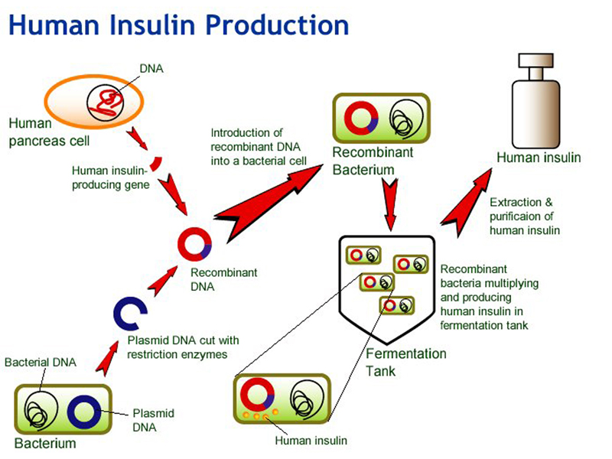

Slide 100
Transfer of the Insulin gene into a plasmid vector.
• The plasmid is cut across both strands by a restriction enzyme,
leaving loose sticky ends to which DNA can be attached
• Special linking sequences are added to the human c DNA so that
it will fit into the loose ends of the opened plasmid DNA ring.
• The plasmid containing the human gene, also called a
recombinant plasmid .now ready to be inserted into another
organism, such as a bacterial cells.
Cloning the Insulin Gene
The recombinant plasmids and the bacterial cells are mixed up.
Plasmids enter the bacteria in a process called transfection.
With the recombinant DNA molecule successfully being inserted
into the bacterial host another property of plasmids that is their
capacity to replicate can be exploited.
Once inside a bacterium, the plasmid containing the human DNA
can multiply to yield several dozen copies.

Slide 101
When the bacteria divide, the plasmids are divided between the
two daughter cells and the plasmids continue to reproduce.
With cells dividing rapidly (every 20 minutes), a bacterium
containing human c DNA (encoding for insulin, for example) will
shortly produce many millions of similar cells (clones) containing
the same human gene.

